Slide 1
EPL Football Analysis

Slide 2





About Football
FIFA
FIFA oversees game play regulations,
organizes competitions, and oversees
the transfer of players- they release stats
every year
Leagues
Various leagues are played across continents and nations. EPL is top tier of England's football pyramid.
Clubs
20 teams battling it out for the honour of being crowned English champions.
Players
Players play for clubs irrespective of nationality and can be traded. 2 transfer windows per year.

Slide 3
Project Significance
“The future of player recruitment is very much complementing traditional scouting with the use of data. Soccer has been later than other sports in embracing data and analytics. It is a world where ‘gut feeling’ and experience in the game is often still valued above statistical evidence.”
- Forbes (2018)

Slide 4





Project Overview
Web Scraping and Cleansing
Descriptive Analysis
Exploratory Analysis
Predictive Analysis
Select Data
01
02
03
04
05
Selected data from SoFIFA.com because it had the most comprehensive player dataset.
Web scraped and cleansed
data from SoFIFA.com in R using the rvest package.
Conducted descriptive analytics to find things such as mean, range and IQR.
Did Exploratory Data Analysis (EDA) to answer key questions
Built a predictive model based on our dataset to predict Rating of a player given factors such as wage, age etc

Slide 5
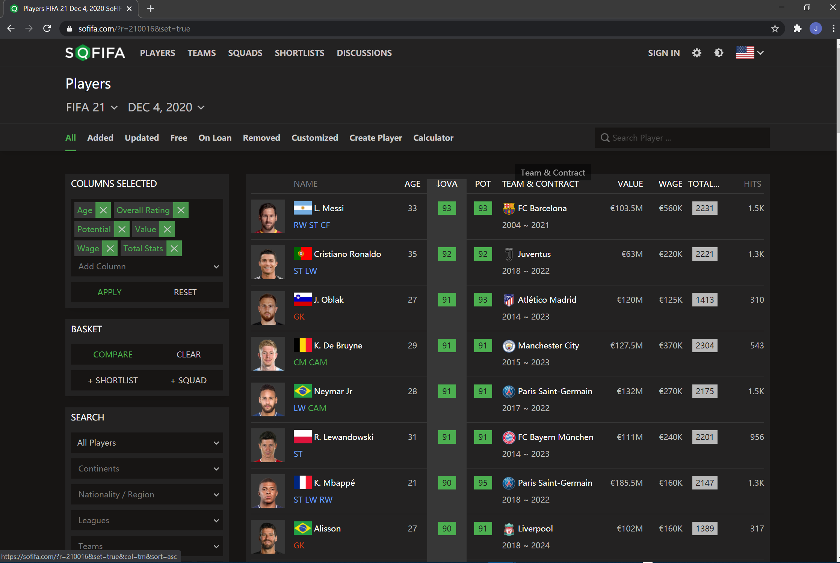
Data Selection

Slide 6



Data Mining and Cleansing
Web Scraping to extract data from SoFIFA.com in R
Step 1
Step 2
Step 3
Using Rvest package, data was scraped for seasons 2015 – 2020. Attributes such as Player Name, Overall Rating, Nationality, Wage, Value eyc were extracted
Preprocessing, Cleaning
Using Tidyverse package, the scraped raw data was pre-processed and cleansed to form structured dataframes.
Data exported to excel for analysis
These dataframes were exported to excel sheets. 5 excel sheets for 5 seasons with roughly 15K observations.

Slide 7
Descriptive Analysis
26
76
Median Age of Entire Player Dataset
Mean Overall Player Rating
€40,680
94
Highest Player Overall Rating
Median Weekly Player Wage

Slide 8
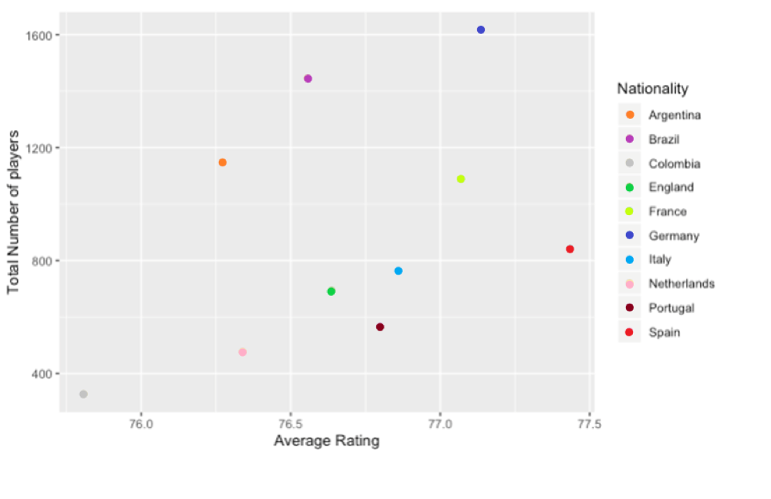
Exploratory Analysis: Q1
Question: Which country produces the most players with the highest collective overall rating?
Answer: Germany. Not surprising that they were the 2014 FIFA and 2017 Confederation Cup champions.

Slide 9
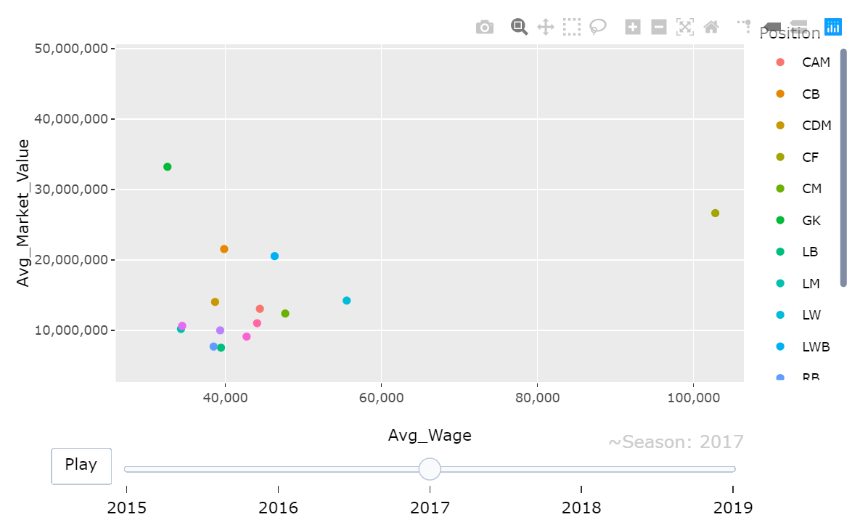
Exploratory Analysis: Q2
Question: Player playing at which position had the highest wage over the years?
Answer: Central Forwards had the highest pay in the 2017 Season.

Slide 10
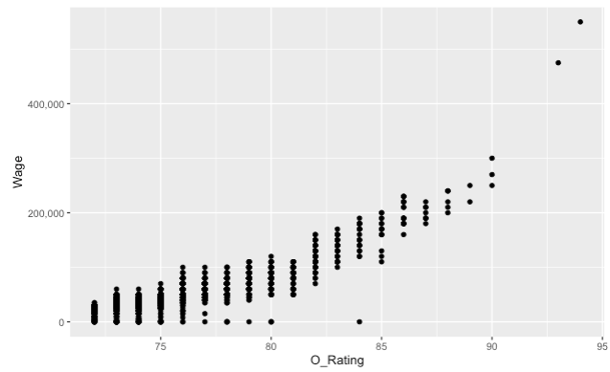
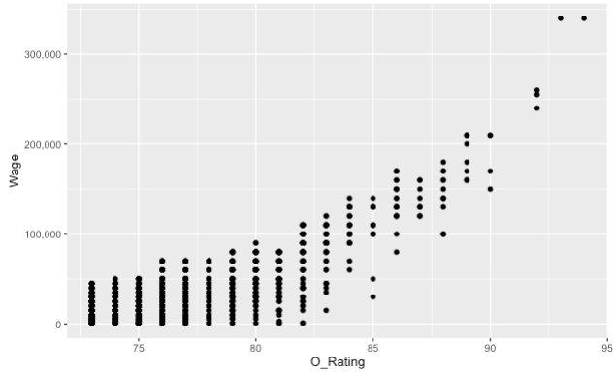
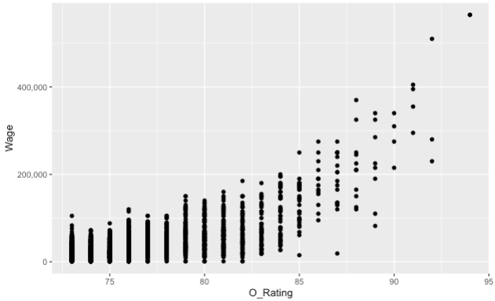
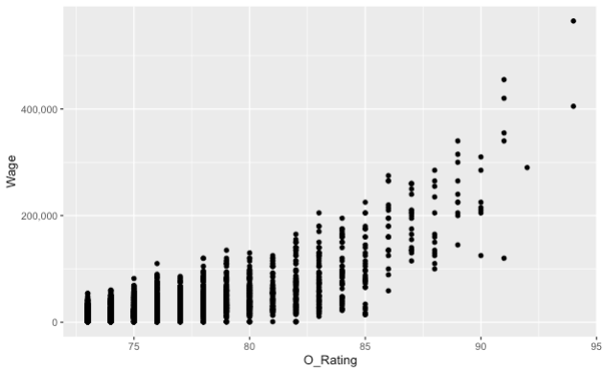

Exploratory Analysis: Q3
2015
2016
2017
2018
2019
Question: What is the correlation between wage and overall rating?
Answer: Initial years show that players with higher O_Rating were paid more compared to later years.

Slide 11
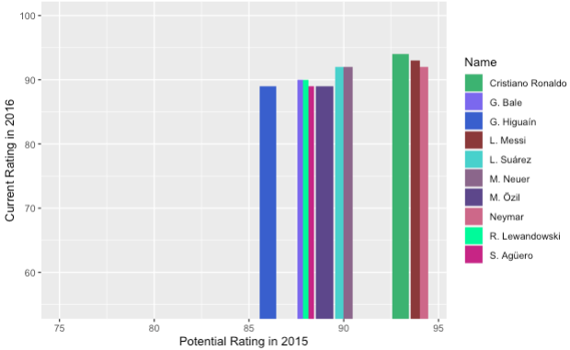
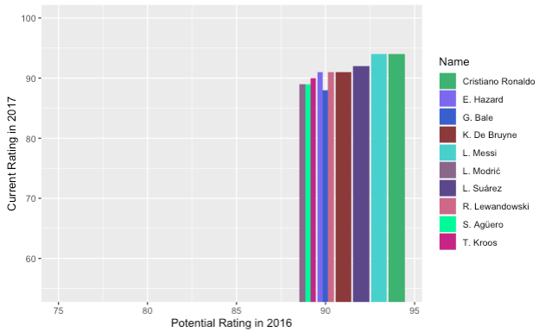
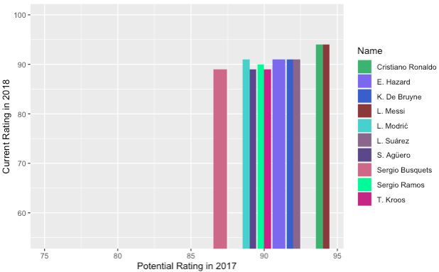
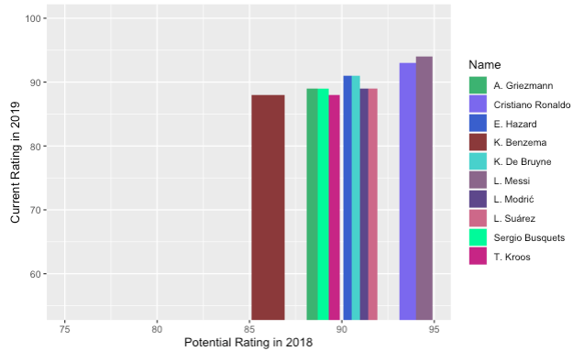
Exploratory Analysis: Q4
Question: Have the highest paid players in the league met their potential rating from the previous year with their current rating from the current year?
Answer: Yes, the highest paid players have improved their YOY performance.

Slide 12
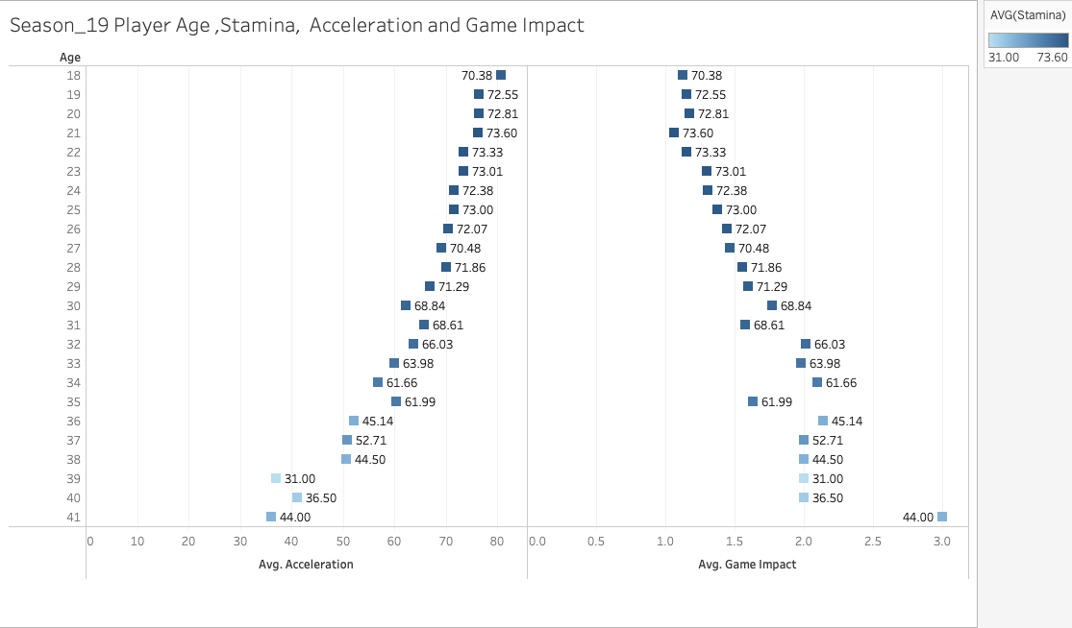
Exploratory Analysis: Q5
Question: What is the correlation between Player Age, Stamina, Acceleration and Game Impact for Season 2019?
Answer: Age 18-29 players have a relatively high stamina, game impact increases with age and acceleration decreases with age.

Slide 13
Predictive Analysis: Linear Multi-Regression Model Building
01
Independent Variables
03
Model Justification based on DV
Age, Stamina, Growth, Maturity, Market Value, Wage
Since most of the variables are numerical variables, logistic regression models were deployed.
02
Dependent Variables
04
Any Preprocessing
- Overall Rating
Operations that hinted that 27 was the peak age of a player compared to their performance. Hence the same set of players who are 27 in 2019 are selected and the same players are analyzed 5 years back to 2015.

Slide 14
Variable Correlations
Wage increases when overall rating increases with a covariance of 0.691
Overall rating and Maturity have a correlation of 0.3375
Overall rating and potential rating have a correlation of 0.679

Slide 15
Model Selection: Backward Elimination

Slide 16

Predictive Analysis: Model Results
Model Accuracy
4 significant variables
P-values= 2e-16 each with 3 stars
Adjusted R-square= 0.638

Slide 17
Interpretation of Results

